Slide 1

INSIZE
Quality Innovation Service Value
INSIZE CO., LTD.
www.insize.com
V.2 08.2026

Slide 2





INSIZE - Founded in 1995, is a dedicated supplier of measuring instruments. To enable us to serve the world-wide market, we are setting up an INSIZE distribution network on a global basis. INSIZE headquarter is located in China. We have branch companies in Canada, USA, Mexico, Brazil, India, Bangladesh, Pakistan, Vietnam, Thailand, Malaysia, Indonesia, Turkey, Taiwan, China, Italy, Czech Republic, France, UK, Romania, Slovenia, Poland, Australia and distributors in over 120 countries. We ensure that wherever you are, our INSIZE products have service and support that are within hands reach. Our dedication to Quality, Innovation, Service and Value has created a worldwide demand for the INSIZE products.
is our standard quality, made in China
is our premium quality, made in Europe

Slide 3


To become the world's leading supplier of industrial measurement solutions,
providing measurement products and services for industrial production,
addressing measurement challenges, continuously innovating, and contributing to social development.

Slide 4

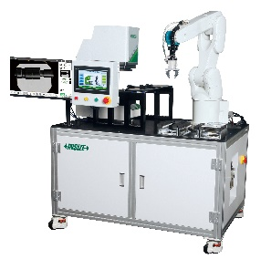

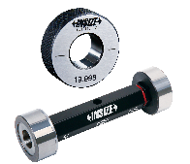
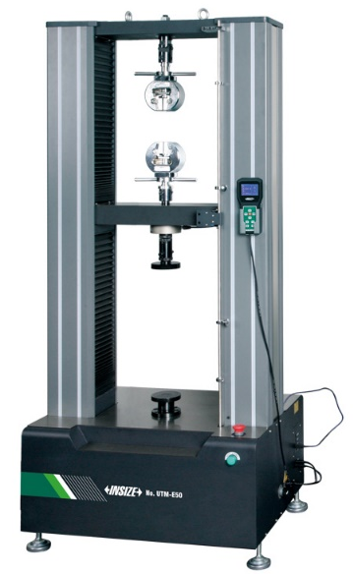
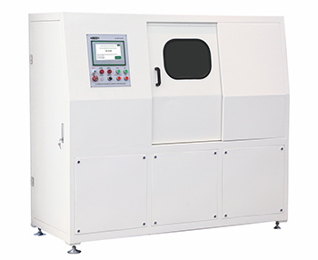
Customized Services

Slide 5


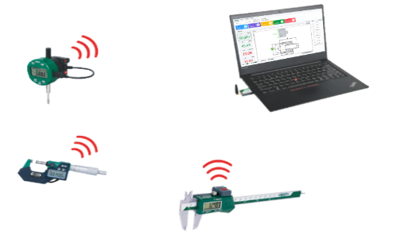
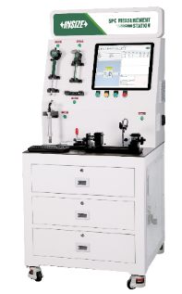
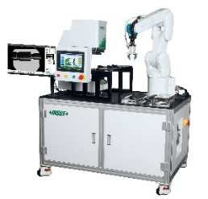
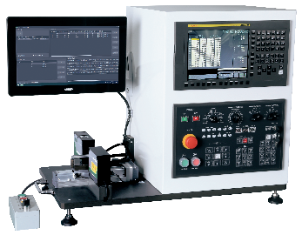
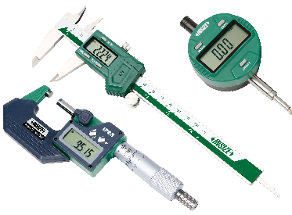
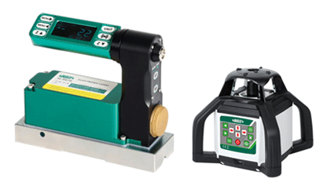
01
01
01
1
2
Smart Measurement
3
Data Output And Software
Automatic Inspection
PRODUCT INDEX
01
01
01
CONTENTS
4
5
6
Automatic Tool
Compensation System
Measuring Tools
Levels

Slide 6
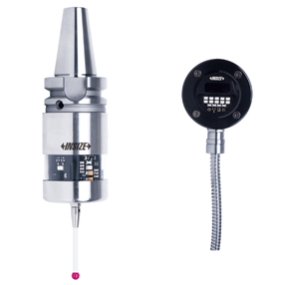
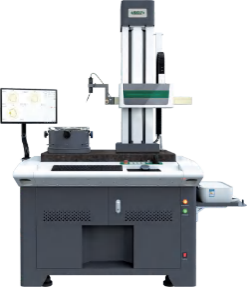
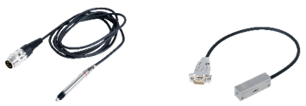
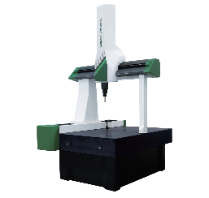
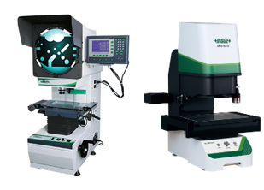
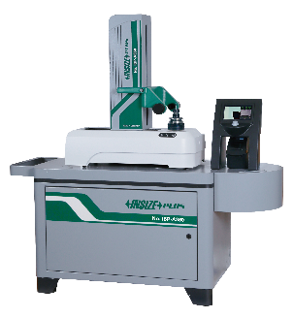
01
01
01
7
8
Linear Probes And Scales
9
Roundness, Profile
And Roughness Testers
On-Machine Measurement
PRODUCT INDEX
01
01
01
CONTENTS
10
3D Measurement
11
Profile Projectors, Quick
Measurement Systems,
Vision Measuring Systems
12
Cutting Tools Inspection

Slide 7
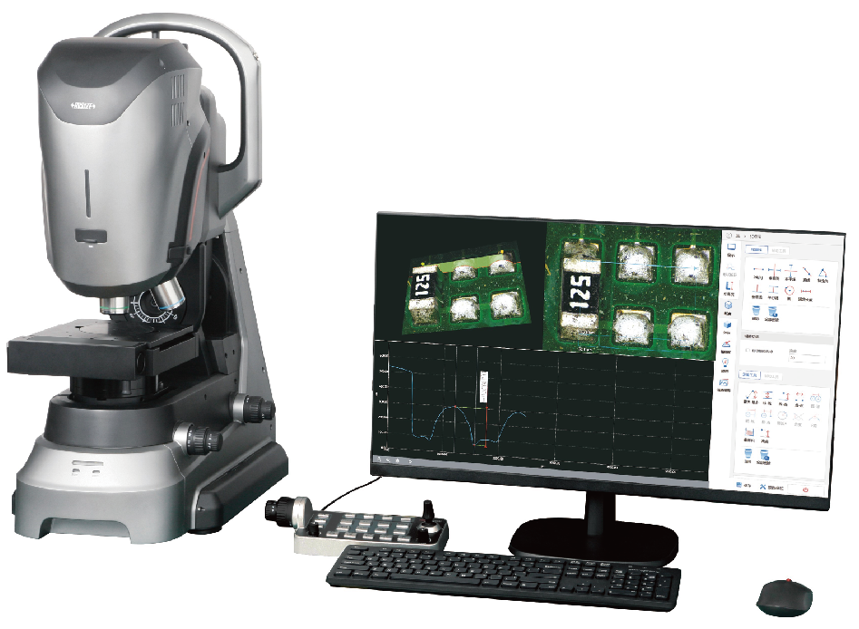
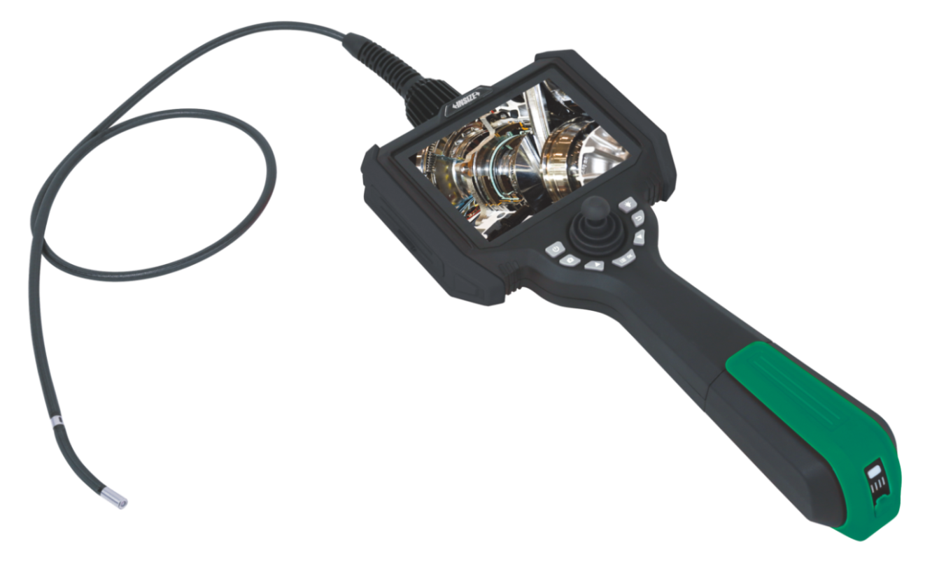
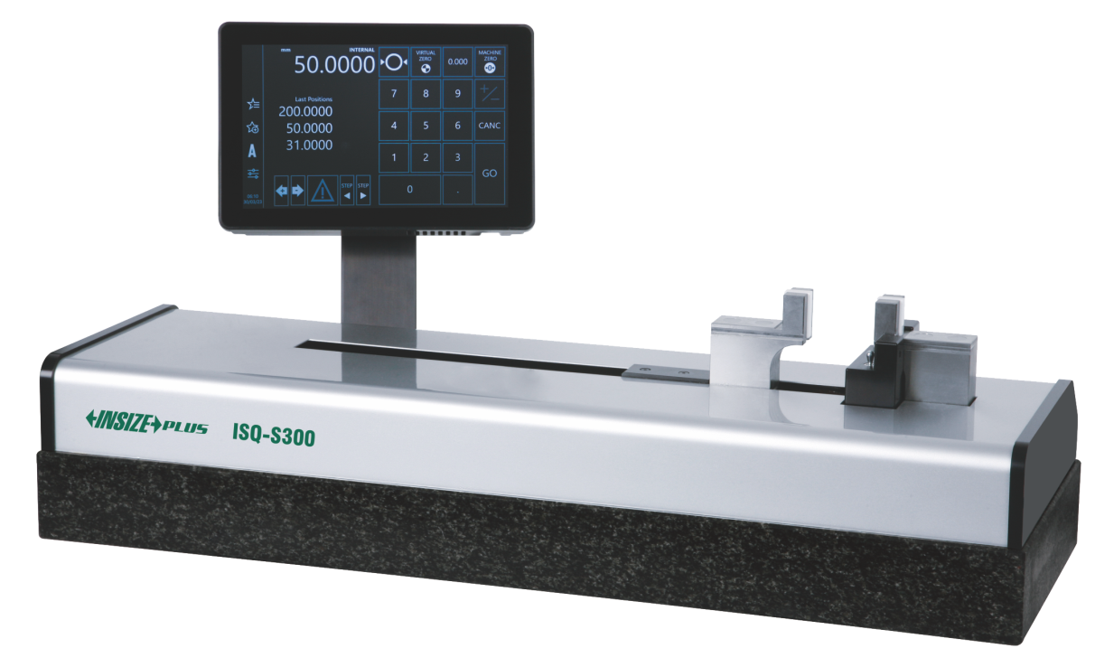
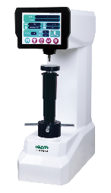
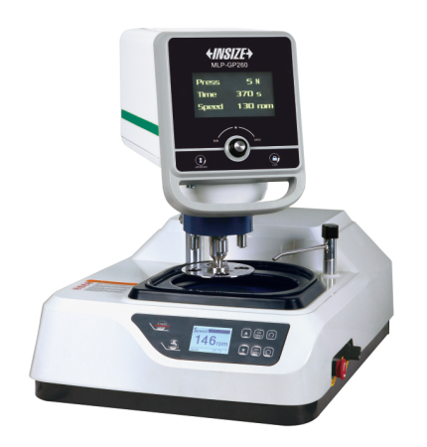
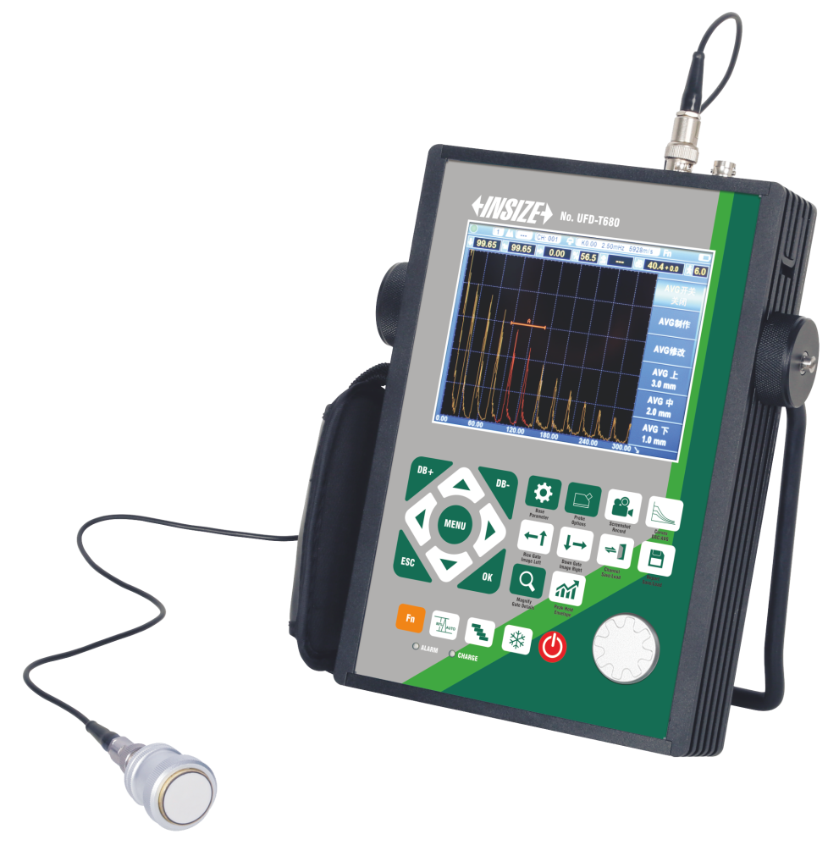
01
01
01
13
Microscopes, Magnifiers
14
Videoscopes
15
Other Dimension
Measuring Instruments
PRODUCT INDEX
01
01
01
CONTENTS
16
Hardness Testers
17
Metallography Preparation
And Analysis
18
Flaw Detectors

Slide 8
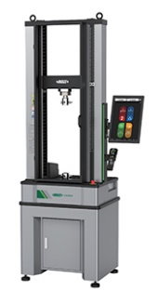
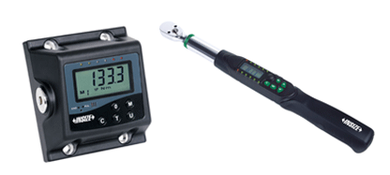
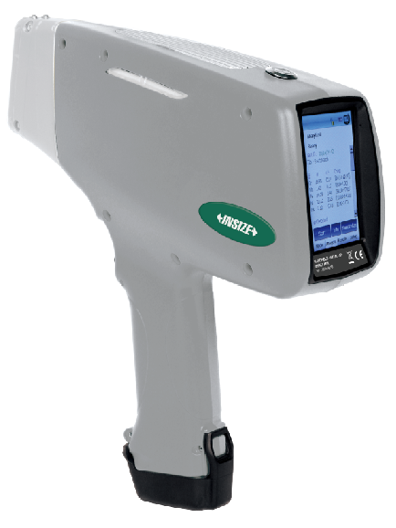
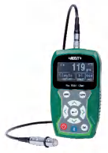
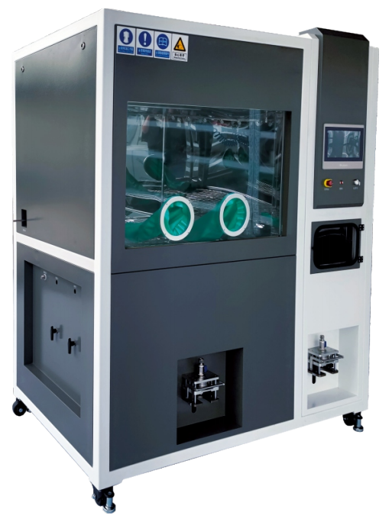
01
01
01
19
Testing Machines, Force
Gauges, Tension Meters
20
Torque Testers,
Torque Wrenches
21
Component Analysis
PRODUCT INDEX
01
01
CONTENTS
22
Coating And Paint Testing
23
Other Instruments

Slide 9

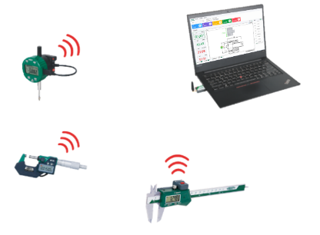
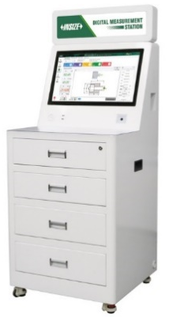
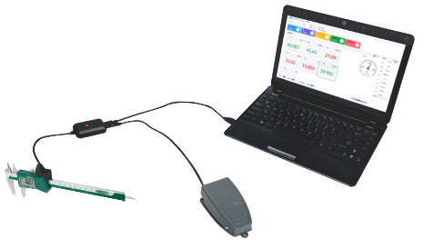
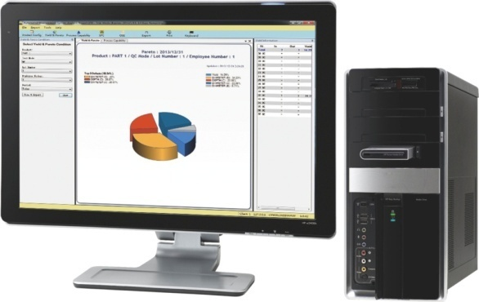

1
Data Output And Software
Wireless Data Transmission
Wired Data Transmission
Measurement Data Management and Analysis Software
Inspection Table

Slide 10

2
Smart Measurement
SPC Measurement Station

Slide 11
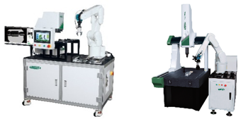
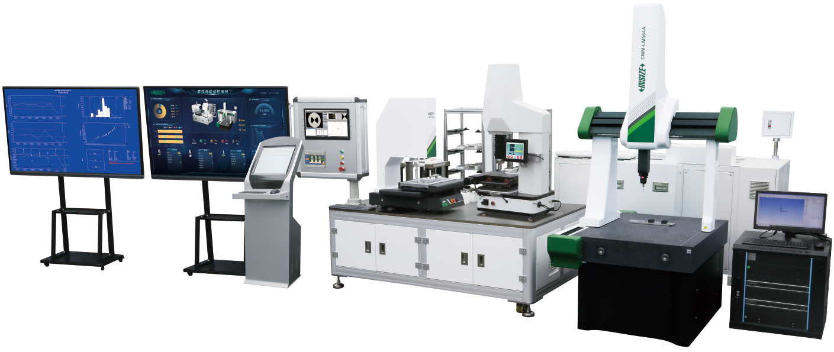
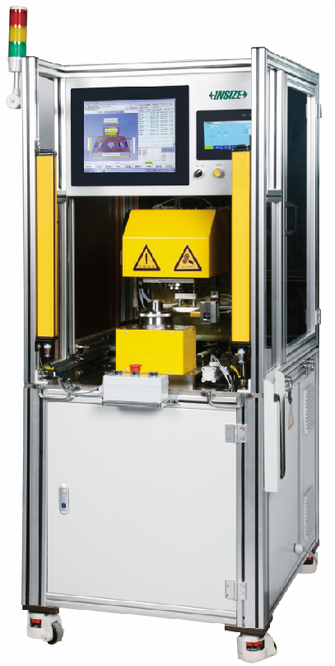
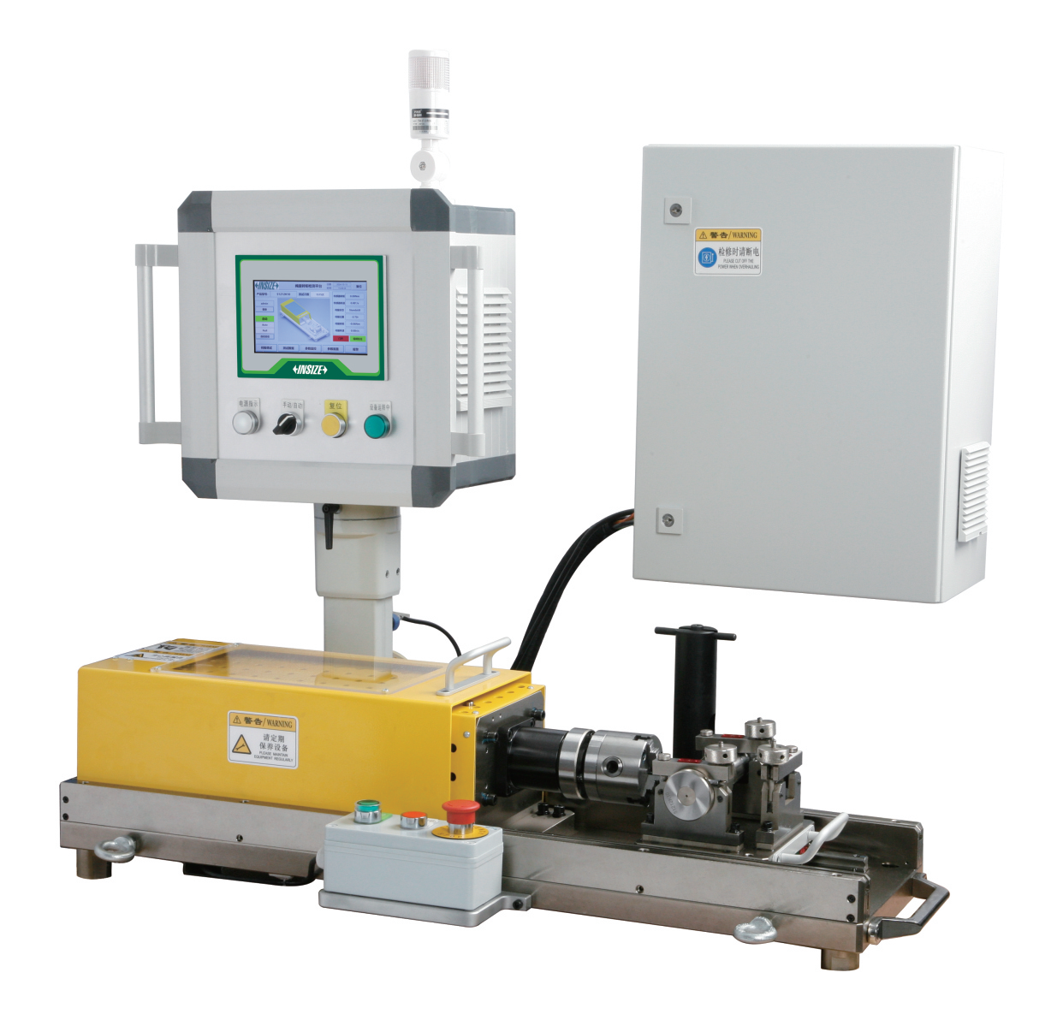
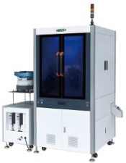
3
Automatic Inspection
Robotic Arm-integrated
Measuring System
Automatic Inspection System
Semi-auto Measurement Stations
Workpiece Torsion Fatigue
Testing Machine
Automatic Vision
Inspection Machine

Slide 12

4
Automatic Tool Compensation System
Automatic Tool Compensation System

Slide 13
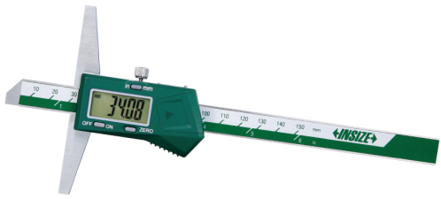
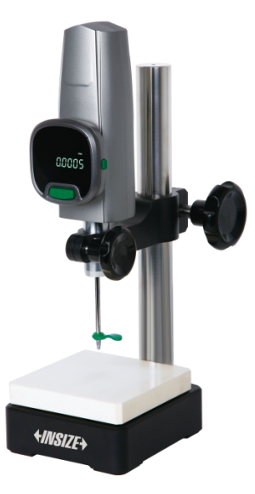
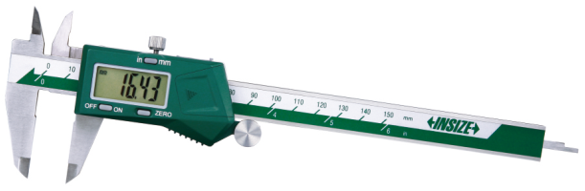
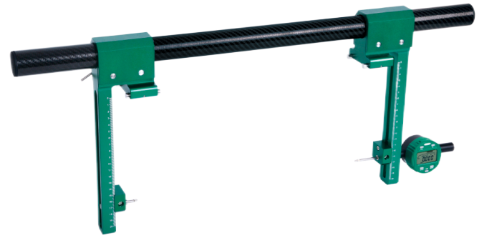
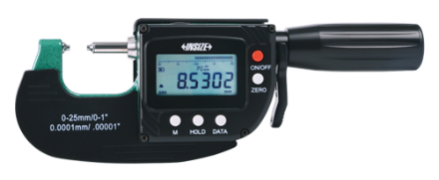
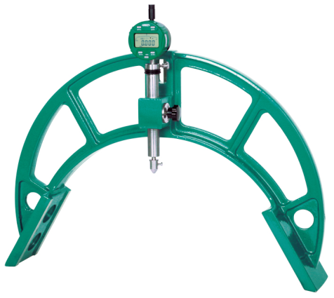
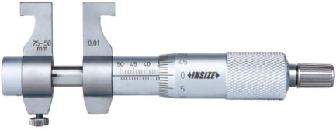
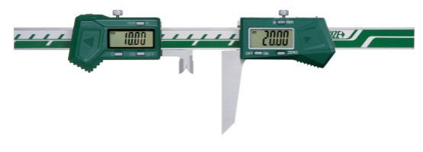
5
Measuring Tools (P1)
Calipers
Depth Measuring Tools
Hight Measuring Tools
Comparison Measuring Tools
Micrometers
Bore Diameter And Circumference Measuring Tools
ARC Radius Measuring Tools
Keyway And Chamfer Measuring Tools

Slide 14
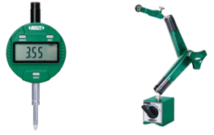
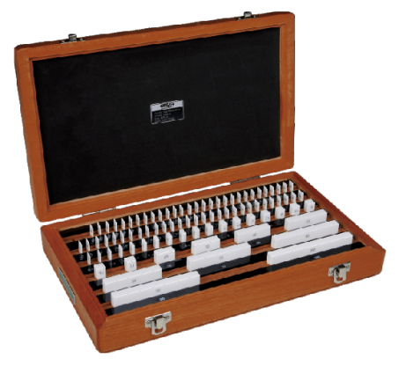
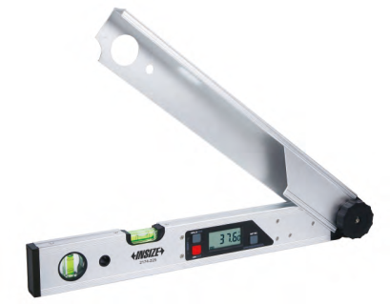
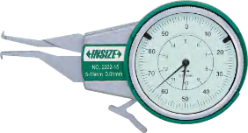
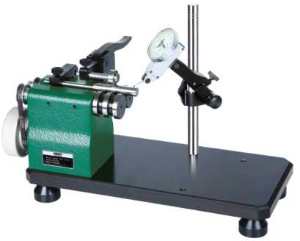
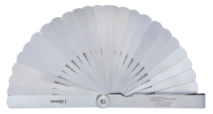

5
Measuring Tools (P2)
Indicators And Dial Indicator Stands
Indicating Measuring Tools
Standards And Gauge Blocks
Angle, Straightness, Flatness Measuring Tools
Concentricity And Runout Testers
Simple Measuring Tools
Set-up Tools

Slide 15










6
Levels
Built-in Bluetooth Electronic Levels
Cylinder Straightness Measuring Instruments
Built-in Bluetooth Digital
Level And Slope Meter
Frame Levels
Block Levels
Imaging Level
Level Bubbles
Levels
Cross-line Laser Levels
Self-Leveling Rotary Lasers

Slide 16











7
On-Machine Measurement
Video Measuring Instrument
For Machine Tools
Centering Indicators
Edge Finders
Edge Finders For EDM
3D Testers
Trigger-type 3D Probes
Transmission Probes For
CNC Machine tools
Vision Zero Setter
Zero Setters With Cable
Zero Setters
Vertical Milling Machine Perpendicularity Measuring Gauges

Slide 17








8
Linear Probes And Scales
Linear Probes
Inductance Probe Displays
Digital Linear Gauges
Capacitance Type Linear
Gauges And Display Units
Laser Displacement Sensors
Linear Scales And Digital Readouts
Magnetic Linear Scales
Scales

Slide 18








9
Roundness, Profile And Roughness Testers
Roundness/Cylindricity Tester
Roundness Measuring Machines
Precision Air Floating Rotary Tables
Surface Profile Measuring Machines
Roughness Measuring Machines
Roughness Testers
Surface Roughness Specimens
Surface Roughness
Reference Specimens

Slide 19









10
3D Measurement
CMM
Workshop Coordinate
Measuring Machines
Measuring Arms
Software For Measuring Arms
Handheld 3D Scanners
Styli For CMM
Ceramic Ball Gauges
Gauge Block Stands for CMM
CMM Check Masters
Jigs For CMM

Slide 20










11
Profile Projectors, Quick Measurement Systems,
Vision Measuring Systems
Profile Projectors
Sheet Metal Vision Measuring Systems
Quick Measurement Systems
Online/Offline Quick
Measurement Systems
CNC Vision Measuring Systems (Standard Type)
CNC Vision Measuring Systems (Advanced Type)
Vision Measuring Softwares
Jig Set For Vision
Measuring Systems
Standard Glass Scales

Slide 21







12
Cutting Tools Inspection
Tool Presetters
Dual-display Cutting Tools Microscope
Cutting Tools Vision Measuring
Systems
Tool Presetter
Laser Measuring Instrument For Tool Diameter/Runout
Shank Runout Testers
Shank Taper Inspection Instruments

Slide 22












13
Microscopes, Magnifiers (P1)
White Light Interference Measuring Microscope
Areal Confocal 3D Microscope
Large Depth Of Field 3D
Measuring Microscopes
Universal Toolmaker Microscope
Motorized Zoom Microscope (Basic Type)
Low-Magnification High-Definition Stereo Microscopes
Metallurgical Microscopes
Metallurgical Microscopes (Advanced Type)
Zoom Stereo Microscopes
Digital Cameras For Microscopes
Metallurgical Analysis Softwares
Digital Depth Measuring Microscope

Slide 23





13
Microscopes, Magnifiers (P2)
Portable Measuring Microscopes
Table Magnifiers
With Illumination
Magnifiers
Telescoping Inspection Mirrors
Telescoping Pick-up

Slide 24







14
Videoscopes
Videoscopes (Desk Type)
Videoscopes
Multipurpose Videoscopes
Carbon Fiber Telescopic Pole Videoscopes
Rigid Borescopes
Cameras (With Display)
Fixture For Rigid Borescopes

Slide 25







15
Other Dimension Measuring Instruments
(P1)
Pen Type Electromagnetic Ultrasonic Thickness Gauges
Built-In Wireless Ultrasonic Thickness Gauge
Hall-effect Thickness Gauge
Glass Thickness Meters
3D Line Laser Profile Measuring Machine
Laser Distance Meters
Laser Scan Micrometers
Automatic Laser Scan Micrometer

Slide 26







15
Other Dimension Measuring Instruments
(P2)
Dual Axis Photoelectric Autocollimators
Linear Laser Interferometer Measurement System
Air Gauges And Displays
Length Presetters (Motorized Type)
Digital Gap Gauges
Manual Putty
Total Stations

Slide 27












16
Hardness Testers (P1)
Rockwell Hardness Testers
Micro-Vickers Hardness Testers
Vickers Hardness Testers
Vickers Hardness Measuring Systems
Brinell Hardness Testers
Rockwell/Brinell/Vickers
Hardness Testers
Brinell Indentation Hardness
Measuring Systems
Brackets
Ultrasonic Hardness Testers
Portable Leeb Hardness Testers
Portable Rockwell Hardness Tester
Aluminum Hardness Testers

Slide 28






16
Hardness Testers (P2)
Aluminum Hardness Testers
Shore Durometers
Fruit Hardness Testers
Hardness Test Blocks
Concrete Strength Testers

Slide 29









17
Metallography Preparation And Analysis
Cutting Machines
Mounting Presses
Grinders And Polishers
Automatic Liquid Droppers
Metallurgical Microscopes
Metallurgical Analysis Softwares
Cutting Machine Accessories
Mounting Press Accessories
Grinder And Polisher Accessories

Slide 30













18
Flaw Detectors (P1)
Portable Eddy Current Flaw Detectors
Ultrasonic Flaw Detectors
Ultrasonic Phased Array Detectors
Standard Test Blocks For Ultrasonic Flaw Detection
Ultrasonic Water Immersion Detection Systems
Online Eddy Current Testing System
Air-Coupled Ultrasonic Detector
Ultrasonic Flaw Detector
For Concretes
Portable Magnetic
Powder Flaw Detectors
Permanent Magnet Yoke Flaw Detector
Fluorescent Magnetic Powder Flaw Detectors
Magnetic Powder Test Blocks

Slide 31










18
Flaw Detectors (P2)
Magnetic Field Indicator Sets
UV Flaw Detection Lights
Penetration Standard Test Blocks
Supplementary Materials
Variable Frequency Portable X-Ray Flaw Detectors
Industrial Automatic X-Ray Film Processor
Industrial Viewing Lamps
Black And White Densitometers
Wire Rope Flaw Detectors

Slide 32












19
Testing Machines, Force Gauges,
Tension Meters (P1)
Electronic Universal Testing Machines
Electronic Universal Testing Machines
High And Low Temperature Test Chambers For Electronic Universal Testing Machines
Hydraulic Universal Testing Machines
Extensometers
Video Extensometers
Gauge Marking Instruments
(Marking Point)
Gauge Marking Instruments
(Marking Line)
Electro-Hydraulic Servo Flexural And Compressive Testing Machines
Servohydraulic Fatigue Testing
Machines
Impact Testing Machines
Impact Standard Samples

Slide 33












19
Testing Machines, Force Gauges,
Tension Meters (P2)
Impact Specimen Notch
Broaching Machines
Impact Specimen Notch Projectors
Impact Broaches
Plastic Pendulum Impact Testing Machines
Melt Flow Index Tester
Steel Bar Bending Testing Machines
Friction And Wear Testing Machines
Friction/Peel Testers
Terminal Tension Testers
Bond Force Testers
Package Drop Testing Machines
Paperboard Bursting Strength Tester

Slide 34













19
Testing Machines, Force Gauges,
Tension Meters (P3)
DIN Abrasion Tester
Pneumatic Key Life Testers
Spring Hammers
Tablet Hardness Tester
Tensile And Compression
Testing Machines
Automatic Spring Testing Machines
Digital Spring Testers
Force Gauges
Test Stands For Force Gauges
Force Gauges
Tensile/Compression Sensors
Tube Force Gauges

Slide 35






19
Testing Machines, Force Gauges,
Tension Meters (P4)
Handheld Force/Torque Indicators
Wire Tension Meters
Cable Tension Meters
Infrared Belt Tension Meter
Belt Tension Meters
Spindle Tension Meters

Slide 36












20
Torque Testers, Torque Wrenches (P1)
Torsion Testing Machines
Torque Testers
Torque Testers
Torque Wrench Test Stands
Dynamic Torque Sensors
Torque Sensors
Handheld Force/Torque
Indicators
Torque Screwdrivers
Desktop Automatic Tightening Machines
Electric Screwdrivers
Torque Testers For Electric Screwdrivers
Digital Torque Wrenches

Slide 37











20
Torque Testers, Torque Wrenches (P2)
Interchangeable Head Preset Digital "Click" Torque Wrenches (WiFi Lan)
Interchangeable Head Production-Grade Color Digital Torque Wrenches (WIFI Lan)
Color Screen Multifunctional Digital Torque Wrenches
Torque Wrenches
Preset Torque Wrenches
Automatic Torque Wrench Calibrator
Dial Torque Wrenches
Torque Adapters
Torque Multipliers
Hydraulic Torque Wrenches With Drive Shaft
Electromagnetic Ultrasonic Bolt Axial Force Tester

Slide 38











21
Component Analysis
Handheld XRF Alloy Analyzers
Handheld LIBS Spectrometers
XRF Spectrometers
XRF Precious Metals Analyzer
XRF Oil Analyzers
Standard Sheets For XRF Plating Thickness Instruments
Spark Direct Reading Spectrometers
Standard Samples For Spectral Analysis
Spectral Sample Grinders
Carbon And Sulfur Analyzers
Oxygen/Nitrogen/Hydrogen
Analyzers

Slide 39











22
Coating and Paint Testing (P1)
Coating Thickness Gauges
Coating Thickness Gauges (Advanced Type)
Coating/Film Thickness Measurement Systems
Calibration Foils For Coating Thickness Gauges
XRF Plating Thickness Instrument/
RoHS Analyzer/Alloy Analyzer
Surface Profile Gauges
Wet Film Gauges
Gloss Meters
Spectrophotometers
Holiday Detectors
Digital Adhesion Testers
Automatic Pencil Hardness Tester

Slide 40







22
Coating and Paint Testing (P2)
Pencil Hardness Testers
Rotational Abrasion Testers
Cross Cut Adhesion Testers
Conical Mandrel Test Apparatus
Impact Testers
ISO Flow Cups
Rotational Viscometers

Slide 41








23
Other Instruments
Industrial Acoustic Imager
Parts Cleanliness Testing Cabinets
Automatic Cleanliness
Analysis Systems
Oil Testing
Bearing Radial Clearance Tester
Contact Angle Goniometer
Laser Position System
Vibration lsolation Platforms

Slide 42

THANKS !
Quality Innovation Service Value

